Slide 1
Codecademy Introduction to Data Analysis
Final Project:
MuscleHub A/B Test
Morteza Mashayekhi
Date: March 17, 2018

Slide 2
Problem Description
Currently, when a visitor to MuscleHub is considering buying a membership, he or she follows the following steps:
Take a fitness test with a personal trainer
Fill out an application for the gym
Send in their payment for their first month's membership
Janet, the manager of MuscleHub, thinks that the fitness test intimidates some prospective members, so she has set up an A/B test.
Visitors will randomly be assigned to one of two groups:
Group A will still be asked to take a fitness test with a personal trainer
Group B will skip the fitness test and proceed directly to the application
Janet's hypothesis is that visitors assigned to Group B will be more likely to eventually purchase a membership to MuscleHub.

Slide 3
Problem Description
Null Hypothesis:
H0: There is no significant difference between visitors in group A and B in terms of purchasing a membership to MuscleHub
Alternative Hypothesis:
H1: Visitors assigned to Group B will be more likely to eventually purchase a membership to MuscleHub.

Slide 4
Data Understanding
Data sets used in this analysis:
visits.csv including: first name, last name, email, gender, and visit date
applications.csv including: first name, last name, email, gender, and application date
fitness_tests.csv including: first name, last name, email, gender, and fitness test date
purchases.csv including: first name, last name, email, gender, and purchase date
Interviews.txt including comments from a few different gym visitors who participated in the A/B test – can be used for qualitative analysis

Slide 5
Data Understanding
visits = pd.read_csv('visits.csv')
application=pd.read_csv("applications.csv")
fitness_test=pd.read_csv("fitness_tests.csv")
purchases=pd.read_csv("purchases.csv")
print visits.describe()
print application.describe()
print fitness_test.describe()
print purchases.describe()
Variable | Frequency
Visits | 6000
Application | 575
Fitness_test | 2500
Purchase | 450

Slide 6
Data Preparation
Merging all data sets using left join function and select cases with visit_date after 7-01-17
Creating new variables: ab_test_group, is_application, and is_purchase using lambda function

Slide 7
Data Analysis
Using groupby function to count the number of cases for following variables:
Number of application in each of group A and B
Number of purchases in each of group A and B

Slide 8
Data Analysis
Why Chi-square test for testing hypotheses?
In this analysis we use chi-square test to test the hypotheses because we aim to compare the proportion of people who applied or purchased a membership between two groups (A and B).
Visits
5004
Fitness Test (Group A)
2504 (50.04%)
Application
250 (9.98%)
No Application
2254 (90.02%)
No Fitness Test (Group B)
2500 (49.96%)
No Application
2175 (87%)
Application
325 (13%)
No Purchase
50 (20%)
Purchase
200 (80%)
Purchase
250 (76.92%)
No Purchase
75 (23.08%)

Slide 9
Data Analysis
Using chi square test we can test the following hypothesis:
There is no significant difference between group A and B visitors in terms of number of applications
Therefore, we found support for alternative hypothesis and can conclude that there is indeed a significant difference between group A and B visitors in terms of number of applications
Ab_test_group | Application | No Application | Total | Percentage | Reject null hypothesis
A | 250 | 2254 | 2504 | 9.98% | Yes Chi-square=0.001 Less than 0.05
B | 325 | 2175 | 2500 | 13%

Slide 10
Data Analysis
Using chi square test we can test the following hypothesis:
There is no significant difference between group A and B members in terms of number of purchases
Therefore, we found no support for alternative hypothesis and can conclude that there is indeed not a significant difference between group A and B members in terms of number of purchases
Ab_test_group | Member | Not Member | Total | Percentage | Reject null hypothesis
A | 200 | 50 | 250 | 80% | No Chi-square=0.432 more than 0.05
B | 250 | 75 | 325 | 76.92%

Slide 11
Data Analysis
Using chi square test we can test the following hypotheses:
There is no significant difference between group A and B visitors in terms of number of purchases
Therefore, we found support for alternative hypothesis and can conclude that there is indeed a significant difference between group A and B visitors in terms of number of purchases
Ab_test_group | Member | Not Member | Total | Percentage | Reject null hypothesis
A | 200 | 2304 | 2504 | 7.98% | Yes Chi-square=0.014 Less than 0.05
B | 250 | 2250 | 2500 | 10%

Slide 12
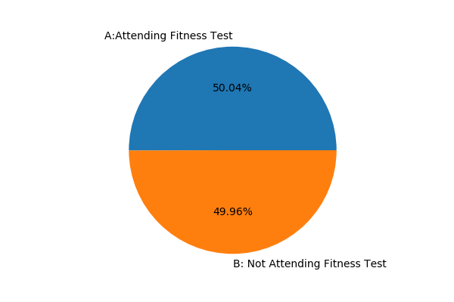
Data Analysis
There is no significance difference between group A and B

Slide 13
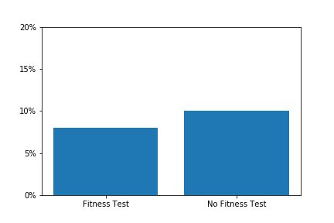
Data Analysis
Percent of Visitors Who Applied
Results of data analysis (chi-square test) shows that There is a significance difference between group A and B visitors in terms of number of applications.

Slide 14
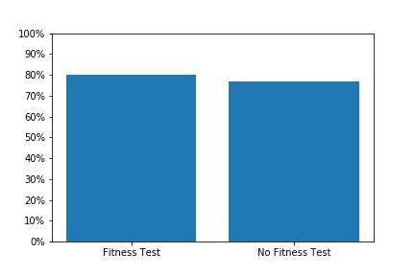
Data Analysis
Percent of members Who purchased
Results of data analysis (chi-square test) shows that There is not a significance difference between group A and B members in terms of number of purchases.

Slide 15
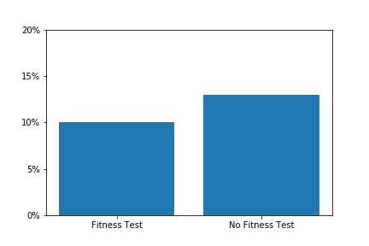
Data Analysis
Percent of Visitors Who Purchase
Results of data analysis (chi-square test) shows that There is a significance difference between group A and B visitors in terms of number of purchases.

Slide 16
Qualitative analysis
The following table shows the results of qualitative analysis based on interviews.txt file
Comments | Positive regarding taking fitness test | Negative regarding taking fitness test
MuscleHub’s introductory fitness test was super helpful for me! After taking the fitness test, I had to sign up | ×
I still ended up not signing up for a membership because the weight machines had all those sweat stains on them and you know, no thanks. |  | ×
I took the MuscleHub fitness test because my coworker Laura recommended it. Regretted it |  | ×
The people there were suuuuuper friendly and the whole sign-up process took a matter of minutes. I tried to sign up for LiftCity last year, but the fitness test was way too intense. |  | ×

Slide 17
Recommendation
Based on results of data analysis, we can conclude that visitors assigned to Group B (the group who skips the fitness test) will be more likely to eventually purchase a membership to MuscleHub. Therefore, we recommend that MuscleHub Company eliminate the step that requires an applicant takes a fitness test before filling out an application from its sign up process.

